Slide 1

Project Presentation on Bank network
AMRUTANSHU PUHAN, FET-BCD-2023-27-013
AAYUSH NANDA, FET-BCD-2023-27-017
ANKIT DAS, FET-BCD-2023-27-018
NIKITA PRIYADARSHINI, FET-BCD-2023-27-019
DR.PRABHUDUTTA PRADHAN, INTERNAL MENTOR
MS.NEHA BAGLE, EXTERNAL MENTOR
Faculty of Engineering & Technology, Sri Sri University, Cuttack.

Slide 2
Contents:
Abstract
Introduction
Literature Review
Objective
Motivation
Problem Statement
Proposed Solution
System Design
Technical Details
Implementation
Testing & Results
Conclusion
References

Slide 3
Abstract
This project focus on designing and implementing secure and reliable bank network. Utilizing advanced encryption protocols and network segmentation to safeguard financial data and prevent unauthorized access. Ensuring minimal downtime and seamless connectivity through efficient network management and security measures. Building a resilient, future-proof banking network that can withstand cyber threats and operational challenges.

Slide 4
Introduction
Project Domain:
Banking Network Security
Project Statement:
To build a scalable and resilient banking infrastructure that ensures security, reliability, and seamless connectivity in the face of increasing cyber threat.
Importance:
Banks handle sensitive transactions, making them prime targets for cyber threats.
Relevance:
This project is relevant because it provides a practical approach in securing banking networks, offering solutions that can be implemented to protect sensitive data.
Network Design:
The network design incorporates key elements such as VLAN segmentation, a DMZ, and potentially a hierarchical topology.
Security Focus:
The project's security focus includes implementing encryption for data protection, firewalls, and access control lists (ACLs) to safeguard sensitive data

Slide 5
Literature Survey/ Existing Work
S. No. | Author(s) | Year | Title | Objective | Methodology | Key Findings | Gaps Identified
1 | K. Sathupadi & S.Achar | 2025 | Real-Time Big Data Analytics for Secure Internet Banking | To create BankNet, a framework for real-time predictions of diverse Internet banking metrics, going beyond fraud detection | Big data analytics via BiLSTM framework and Apache tools. | BankNet enables real-time predictions, handles data rates of 700–1000 Mbps, and achieves high predictive accuracy | Real-time prediction of diverse banking metrics addresses prior gaps.
2 | N.Sarto | 2024 | Digital Banking: How Social Media is Shaping the Game | To reveal the profound impacts of digital transformation on the banking sector, emphasizing key implementation areas | Theoretical relationships confirmed via replication; bias mitigated by independent validation. | The study reveals profound impacts of digital transformation on the banking sector, emphasizing key implementation areas | The abstract provides a general overview but does not explicitly list gaps identified.

Slide 6
Literature Survey/ Existing Work
S. No. | Author(s) | Year | Title | Objective | Methodology | Key Findings | Gaps Identified
3 | Jia et al. | 2023 | Digital Financial and Banking Competition Network | To study how digital finance reshapes the banking competition structure | Competition analyzed using social network model, leveraging bank data and a converted digital finance index. | Digital finance increases competition; large banks retain dominance in the evolving landscape. | Competition through relationships & digital finance impacts.
4 | A.Casolaro& G. Rauber | 2024 | Open Banking: A Systematic Literature Review | A systematic review of open banking’s impact on financial institutions and consumer relationships. | Open banking's impact on financial institution-consumer relationships. | Balances benefits (competition/access) with data privacy risks. | Open banking's impact on consumers and financial models.

Slide 7
Literature Survey/ Existing Work
S. No. | Author(s) | Year | Title | Objective | Methodology | Key Findings | Gaps Identified
5 | P.Singh, Dr. P. Kumar & Dr. Anjula | 2022 | A Review of the Literature on Banking and Financial Institutions | Examines banking's role in economic development, summarizing key findings, methods, and practical implications. | 24 articles (2006-2021) on banking performance, satisfaction, stability, innovation, & development. | Correlated bank performance with growth, satisfaction, lending, innovation, and crisis factors. | Calls for more research on banks' evolving role and technological impacts on performance.
6 | S.Rastogi, A.Sharma & G.Pinto | 2022 | A Literature Review of Risk, Regulation, and Profitability of Banks Using a Scientometric Study | Analyzes regulation, profitability, and risk to inform policy recommendations. | Scopus database analyzed with scientometric tools: network, citation, & page rank. | Concentration, market power & reduced competition linked to decreased bank stability/profitability. | Inadequate research on ownership's impact on bank performance identified.

Slide 8
Literature Survey/ Existing Work
S. No. | Author(s) | Year | Title | Objective | Methodology | Key Findings | Gaps Identified
7 | A.Jiravichai & R.Banomyong | 2022 | A Proposed Methodology for Literature Review on Operational Risk Management in Banks | To propose a methodology that enables researchers to identify relevant search terms when conducting a literature review. | Employed a systematic literature review and an evaluation of existing ORM researh methodologies. | Enhanced keyword selection for ORM analysis , reveals measurement and data availabilty challenges; fosters interdisciplinary accuracy. | Scarce data limits understanding of loss events' impact on rivals/shareholders; empirical reliability questioned.
8 | Kaur et al. | 2022 | Financial technology and competition | To characterize competition, its impact on banks’ business models, and the accessibility and price of services for customers. | Review of economic literature on financial technology and competition for banking services. | Innovation & competition driven by fintech in banking; P2P models challenge banks. | Financial technology may introduce new channels of transmission from competition to financial stability

Slide 9
Objective
1. Ensure High Availability: To implement redundant systems and enable failover mechanisms to limit the occurrence of network downtime.
2. Improve Network Performance: Ensure rapid, predictable, and reliable transfer of data to accommodate massive workloads and critical applications.
3. Cost Efficiency: Balance infrastructure cost with the need for reliability and performance by applying modern cost-effective technologies.
4. Proactive Monitoring and Maintenance: Detect and eliminate problems in real-time through network monitoring and management.
5. Future-Proofing the Network: Implement the latest technologies such as SD-WAN, 5G, to stay in pace with changing times. The network needs to evolve with technology.

Slide 10
motivation
Inspired by the increasing cyber threats targeting the banking sector, the goal is to design a secure banking network addressing challenges such as data breaches, unauthorized access, downtime, and network inefficiencies. The objective is to create a secure network featuring encrypted transactions, VLAN segmentation, and a DMZ. The approach involves implementing encryption for data protection, VLANs for network segmentation, and a DMZ for secure external access. The ultimate goal is to build a scalable and resilient banking infrastructure that ensures security, reliability, and seamless connectivity

Slide 11
Problem statement
Design a highly secure and reliable network for a bank's headquarters and branches that ensures encrypted inter-branch communication, departmental segmentation using VLANs, and a DMZ for public services—while implementing robust firewall and failover mechanisms for uninterrupted 24/7 availability.

Slide 12
Proposed solution
Implementation of VLANs and Access Control:
Segment network traffic by department using VLANs (e.g., Customer Service, Loans, IT Operations). Use Access Control Lists (ACLs) to manage traffic flow and enhance internal security.
DMZ Configuration for Public-Facing Services:
Establish a DMZ to securely host online banking and other external applications. Isolate these from the internal network to prevent lateral movement in case of breaches.
End-to-End Encryption Mechanisms:
Use IPsec VPNs for secure communication between branches and HQ. Ensure SSL/TLS encryption for online banking services and internal web-based tools.
Firewall Configuration and Intrusion Prevention:
Deploy advanced firewalls with IPS features to block malicious traffic, detect anomalies, and enforce security policies consistently across the network.

Slide 13
Proposed solution
Implementation of VLANs and Access Control:
Segment network traffic by department using VLANs (e.g., Customer Service, Loans, IT Operations). Use Access Control Lists (ACLs) to manage traffic flow and enhance internal security.
DMZ Configuration for Public-Facing Services:
Establish a DMZ to securely host online banking and other external applications. Isolate these from the internal network to prevent lateral movement in case of breaches.
End-to-End Encryption Mechanisms:
Use IPsec VPNs for secure communication between branches and HQ. Ensure SSL/TLS encryption for online banking services and internal web-based tools.
Firewall Configuration and Intrusion Prevention:
Deploy advanced firewalls with IPS features to block malicious traffic, detect anomalies, and enforce security policies consistently across the network.

Slide 14
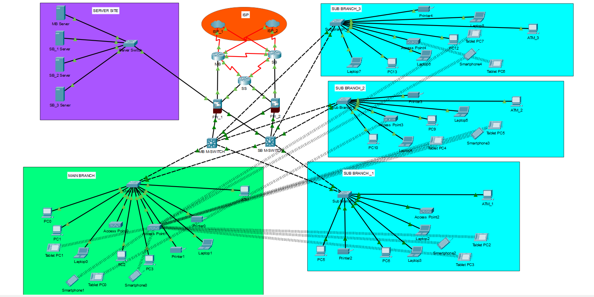
System Design

Slide 15
Technical Details:-
Hardware:-
ML Switch , Normal Switch , Routers , Firewall , PCs , Servers , Printers , Access Points , Laptop , Smart-Phones, Tablet
Software:-
DHCP for IP allocation , VLAN for configuration and Trunking , Inter-VLAN Routing , ACL implementation for Intra-Vlan security , NAT support for internet connectivity , HSRP for Redundancy, OSPF
IP Address:-
VLAN:- 6 VLANS are used subnetting.
Branch | Subnet | Used Range | Devices
Main Branch | 192.168.20.0 | 192.168.20.1–254 | 9 devices + ATM
Sub Branch 1 | 192.168.10.0 | 192.168.10.1–254 | 6 devices + ATM
Sub Branch 2 | 192.168.11.0 | 192.168.11.1–254 | 6 devices + ATM
Sub Branch 3 | 192.168.12.0 | 192.168.12.1–254 | 7 devices + ATM
Server Site | 192.168.30.0 | 192.168.30.1–254 | 4 servers

Slide 16
Implementation:-
VLAN’S were added which were 6 in number :-
1.Server site 2.Sub-Branch1 3. Sub-Branch2 4. Sub-Branch3 5.Main Branch 6.DMZ Zone
Redundant ISP & SD-WAN: Dual ISP links with SD-WAN enable dynamic path selection and uninterrupted connectivity.
Firewall & DMZ Setup: Firewalls secure inter-branch traffic; DMZ hosts public services like online banking.
Server Site Deployment: Centralized servers connect via a high-speed switch for core banking applications.
Core Switching & Interconnectivity: Main switches connect all branches to the server and internet securely.

Slide 17
Testing & Results:-
The proposed banking network was tested in Cisco Packet Tracer, focusing on VLAN communication, security, and redundancy. Inter-VLAN routing was successful, and ACLs effectively restricted unauthorized access, especially between the DMZ and internal VLANs. Public access to DMZ services was verified, and VPN simulation ensured secure branch-to-HQ communication. HSRP provided seamless failover, while NAT enabled Internet access for internal users. Overall, the design met all objectives of security, availability, and performance.

Slide 18
Conclusion
A system designed for seamless inter-branch communication utilizes client-server or peer-to-peer networking with LAN or VPN for secure data transfer. Security is ensured through encryption, firewalls, and multi-factor authentication. The tech stack includes TCP/IP, SQL databases, VPNs, and firewalls for stable and secure operations.

Slide 19
references
Cele, N.N. and Kwenda, S. (2025) Identified identity theft, malware attacks, phishing, and vishing as significant cybersecurity threats hindering digital banking adoption. The study also summarized 13 preventive tools.
Judijanto, L., Kaaffah, F.M., Muthmainah, H.N., and Vandika, A.Y. (2024) Explored computer network security's role in safeguarding financial data and customer trust in Indonesia's digitalizing financial sector. It highlights the need for collaborative efforts to address cybersecurity challenges.
North Press (2024) This literature review explores the pivotal role of computer network security in safeguarding financial data, transactions, and customer trust within this dynamic context.
Acharya, S. and Joshi, S. (2020) Studied the impact of cyber-attacks on banking institutions in India, focusing on safety mechanisms and preventive measures.
Vanini et al. (2021) Emphasized that all parties involved in digital transactions must remain aware of cyber threats and update their knowledge to minimize the adverse impacts on digital banking adoption.
Accenture (2019) Provided insights into the cost of cybercrime in the USA

Slide 20
Thank you

